Slide 1
Artificial Intelligence
Enrique Peláez Ph.D.

Slide 2
Agenda
  Machine Learning
    Neural Networks
    Genetic Algorithms
  Applications

Slide 3
Neural Networks

Slide 4
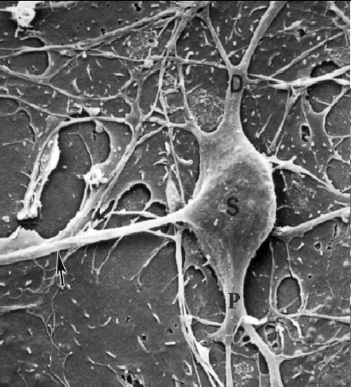
Neural Networks
http://www.4colorvision.com/pix/pyramidpix.gif

Slide 5
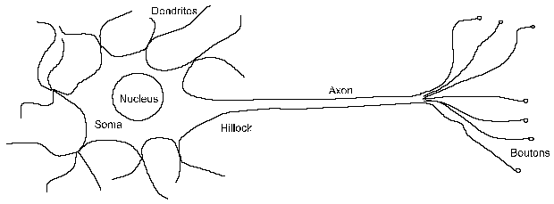
Neural Networks

Slide 6
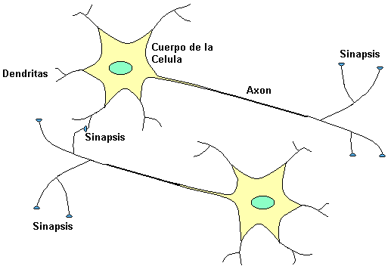
Neural Networks
Machine Learning, Tom Mitchell

Slide 7
Neural Networks
Biological Neuron – How it works
  The brain consists of a big number (~ 10¹¹) of highly interconnected elements (~ 10⁴ connections per element), named neurons.
  The neurons have 3 main components: the dendrites, body-nucleus of the cell or soma, and the axon.

Slide 8
Neural Networks
Biological Neuron – How it works
  The brain consists of a big number (~ 10¹¹) of highly interconnected elements (~ 10⁴ connections per element), named neurons.
  The neurons have 3 main components: the dendrites, body-nucleus of the cell or soma, and the axon.
    The dendrites are the receptor tree of the net, they are like nervous fibers that charge the body of the cell with electrical signals.
    The body of cell makes the sum of those input signals.
    The axon is a large fiber that carries the signal from the body of the cell to other neurons.
  The point of contact of the axon from a cell with the dendrite of another cell is called synapses.
  The length of the synapses is determined by the complexity of a chemical process that stabilizes the operation of a neural net.

Slide 9
Neural Networks
If a neuron fires, an electrical impulse is generated. This impulse starts at the base, called the hillock, of the axon, and proceeds down to its end.
The end of the axon is actually split into multiple ends, called the boutons. Boutons are connected to the dendrites of other neurons and the resulting interconnections are the synapses. (Actually, the boutons do not touch the dendrites; there is a small gap between them.)
If a neuron has fired, the electrical impulse generated stimulates the boutons and results in electrochemical activity which transmits the signal across the synapses to the receiving dendrites.

Slide 10
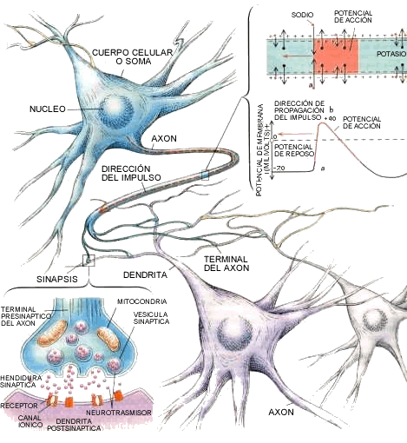
Neural Networks
Neural networks, SimonHaykin

Slide 11
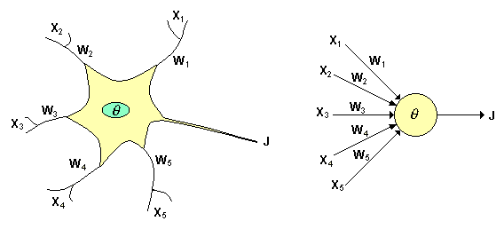
Neural Networks
An artificial system
Machine Learning, Tom Mitchell

Slide 12
Neural Networks
From the bilogical process we have found the following analogies with the artificial system:
  The inputs Xi represent the signals coming from other neurons, which are captured by the dendrites.
  The weights Wi represent the intensity of the synapses that connect 2 neurons. Xi and Wi are real values.
  Ө is the threshold function that the neuron has to overpass to get activated. In the biological neuron, this process occurs in the body of the cell.

Slide 13
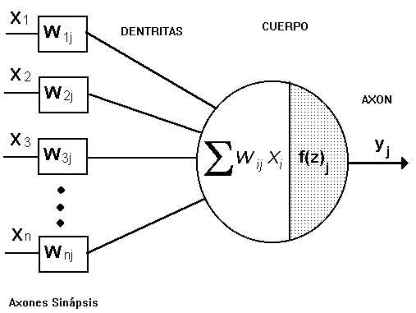
Neural Networks
DENDRITES

Slide 14
Neural Networks
This model is known as the Perceptron, introduced by McCulloch and Pitts. It is the base for most of the current architectures of neural nets.
Neurons use different activation functions based on the application, sometimes they are linear functions, or sigmoid, etc. for thresholding.
The synapses efficiency is represented by weights interconnection factors W_{ij}, from neuron i, to neuron j.

Slide 15
Neural Networks
DENDRITAS

Slide 16
Neural Networks
Weights can be positive (excitatory) o negative (inhibitory).
Weights along with activation functions f(z) dictate the operation of a neural net.
Normally activation functions can not be modified, but the state of a neural net depends on the weight factors (synapses) applied to the neuron.
In a perceptron, each input is multiplied by the corresponding weight W; then all results are summed and compared against a threshold value, if the result is bigger than the threshold, then the perceptron is activated.

Slide 17
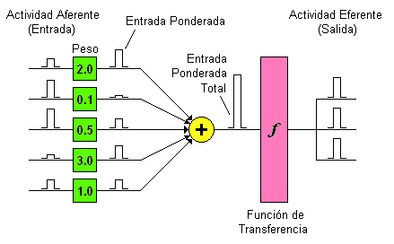
Neural Networks
Machine Learning, Tom Mitchell

Slide 18
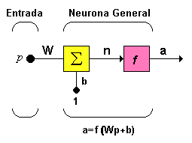
Neural Networks
Funciones de Transferencia:

Slide 19
Neural Networks
Network inputs are represented by a vector p. In one neuron there is only one element.
W represents the weight and the input b is a gain that helps strengthen the output of the sum n, which represents the actual output of the network.
The total output a, is determine by the transfer function, which can be linear or not of n, and it is chosen based on the problem description.
Although artificial neural nets are inspired upon their biological counterparts, there are not limitations on the output functions.

Slide 20























Neural Networks
Nombre
Relación
Entrada /Salida
Icono
Función
Limitador Fuerte
hardlim
Limitador Fuerte Simétrico
hardlims
Lineal Positiva
poslin
Lineal
purelin
Lineal Saturado
satlin
Lineal Saturado Simétrico
satlins
Sigmoidal Logarítmico
logsig
Tangente Sigmoidal Hiperbólica
tansig
Competitiva
compet

